Slide 1
Project 5:Sentiment Analysis for Marketing
PHASE-4: DEVELOPMENT PART 2

Slide 2
Feature Engineering
df[numeric].describe()
 | total_comments | likes | rating
count | 5007.000000 | 5007.000000 | 5007.000000
mean | 0.030957 | 5.419013 | 4.488516
std | 0.589596 | 125.406026 | 1.086279
min | 0.000000 | 0.000000 | 1.000000
25% | 0.000000 | 0.000000 | 4.000000
50% | 0.000000 | 0.000000 | 5.000000
75% | 0.000000 | 0.000000 | 0.000000
max | 24.000000 | 5087.000000 | 5.000000

Slide 3
for idx, col in enumerate(categoric):
if col=='review_text' or col=='review_title': continue
print(f'{df[col].nunique()} unique values found: {df[col].unique()}')
1 unique values found: ['Apple iPhone XR (64GB) - Black']
1 unique values found: [' India ']
1 unique values found: ['Apple']
4097 unique values found: ['Sameer Patil' 'Amazon Customer' 'A' ... 'Shreya' 'murali hv' 'basil john p']
df.drop(['product', 'review_country', 'product_company', 'profile_name'], axis=1, inplace=True)
def get_review(x):
return x.review_title+': '+x.review_text
df['full review']=df.apply(get_review, axis=1)
df.drop(['review_text', 'review_title'], axis=1, inplace=True)
df['sentiment']=np.where(df.rating>=3, 'Positive', 'Negative') plt.pie(df.sentiment.value_counts(), labels=df.sentiment.unique(), autopct='%.0f%%')

Slide 4
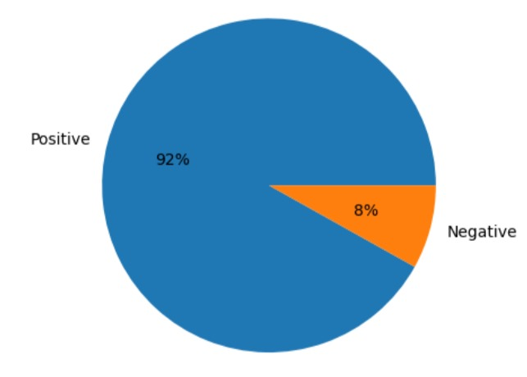
([<matplotlib.patches.Wedge at 0x7f36cb66ba90>, <matplotlib.patches.Wedge at 0x7f36cb6103d0>],
[Text(-1.0645015604617463, 0.2771938451237825, 'Positive'), Text(1.0645015799263142, -0.27719377037441, 'Negative')], [Text(-0.580637214797316, 0.15119664279479042, '92%'), Text(0.5806372254143531, -0.15119660202240542, '8%')])

Slide 5
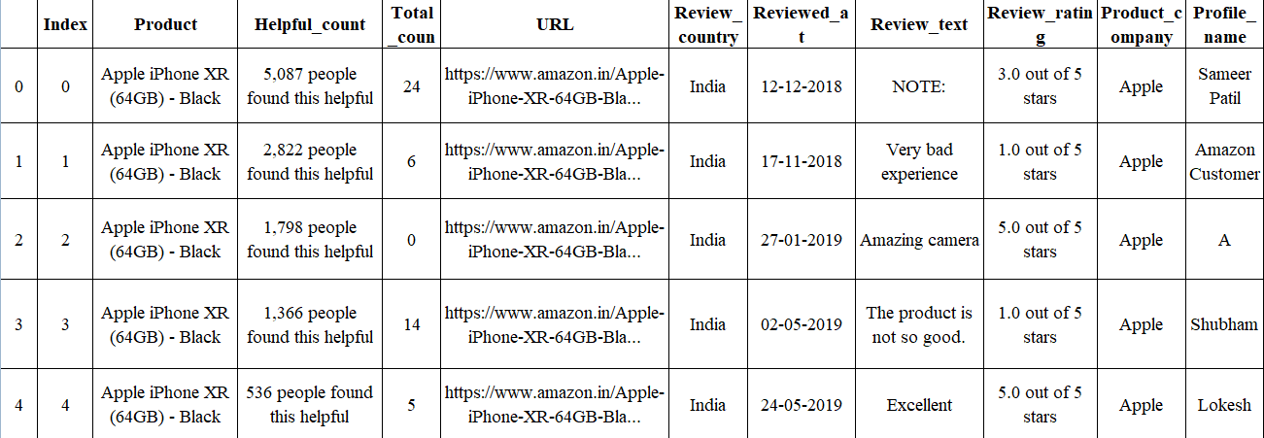
df.head()

Slide 6
Model Training
nlp = spacy.load("en_core_web_sm")
df['full review'][50]
'Go for iPhone XR 256GB!: A lot of criticism of iPhone XR has been about its inability to take portrait pics of “only human faces!” Though true, it can be very easily overcome by downloading a software app - “Halide!” That and the near negligible difference in viewing experience, puts it on par with iPhone XS and even XS Max! Just go for it— the 256 GB storage version!‘
doc=nlp(df['full review'][50].lower())
for token in doc:
print(token)

Slide 7
go for iphone xr 256
gb ! : a lot
of criticism of iphone xr
has been about its inability
to take portrait pics of
“ only human faces !
” though True , it
can be very easily overcome
By downloading a software app
“ halide ! ” that
and the near negligible difference
in viewing experience , puts
it on par with iphone
xs and even xs max
! just go for it —
the 256 gb storage version !

Slide 8
tokens=[token for token in doc if not token.is_stop] tokens
[iphone, xr, 256, gb,
!, :, lot, criticism,
iphone, xr, inability, portrait,
pics, “, human, faces,
!, ”, true, ,,
easily, overcome, downloading, software,
app, -, “, halide,
!, ”, near, negligible,
difference, viewing, experience, ,,
puts, par, iphone, xs,
xs, max, !, —,
256, gb, storage, version, !]

Slide 9
tokens = [token for token in tokens if not token.is_punct] tokens
[iphone, xr, 256, gb, lot,
Criticism, iphone, xr, inability,
portrait, pics, human, faces, true,
easily, overcome, downloading, software, app,
halide, near, negligible, difference,
viewing, experience, puts, par,
iphone, xs, xs, max, 256,
gb, storage, version]

Slide 10
tokens = [token.lemma_ for token in tokens] tokens
['iphone', 'xr', '256', 'gb',
'lot‘, 'criticism', 'iphone', 'xr',
'inability', 'portrait', 'pic', 'human',
'face', 'true', 'easily‘, 'overcome',
'download', 'software', 'app', 'halide',
'near', 'negligible', 'difference', 'view',
'experience‘, 'put', 'par', 'iphone',
'xs', 'xs', 'max', '256',
'gb', 'storage', 'version']

Slide 11
' '.join(tokens)
'iphone xr 256 gb lot criticism iphone xr inability portrait pic human face true easily overcome download software app halide near negligible difference view experience put par iphone xs xs max 256 gb storage version‘
def preprocess(x):
doc=nlp(x.lower())
tokens=[token for token in doc]
tokens=[token for token in doc if not token.is_stop and not token.is_punct and not token.is_digit] tokens=[token.lemma_ for token in tokens]
return ' '.join(tokens)
df['clean text']=df['full review'].apply(preprocess)

Slide 12
import numpy as np
from sklearn.feature_extraction.text import TfidfVectorizer
from sklearn.naive_bayes import MultinomialNB
data = np.loadtxt('iphone_purchase_reviews.csv', delimiter=',', dtype=str)
vectorizer = TfidfVectorizer(stop_words='english')
X = vectorizer.fit_transform(data[:, 0])
X_train, X_test, y_train, y_test = train_test_split(X, data[:, 1], test_size=0.25)
clf = MultinomialNB()
clf.fit(X_train, y_train)
y_pred = clf.predict(X_test)
accuracy = np.mean(y_pred == y_test)
print('Accuracy:', accuracy)

Slide 13
Evaluation
import numpy as np
from sklearn.feature_extraction.text import TfidfVectorizer
from sklearn.naive_bayes import MultinomialNB
data = np.loadtxt('iphone_purchase_reviews.csv', delimiter=',', dtype=str)
vectorizer = TfidfVectorizer(stop_words='english')
X = vectorizer.fit_transform(data[:, 0])
clf = MultinomialNB()
clf.load('sentiment_analysis_model.h5')
y_pred = clf.predict(X[data[:, 1] == 'Evaluating'])
positive_reviews = np.sum(y_pred == 'positive')
negative_reviews = np.sum(y_pred == 'negative')
neutral_reviews = np.sum(y_pred == 'neutral')
print('Percentage of positive reviews:', positive_reviews / np.sum(y_pred) * 100)
print('Percentage of negative reviews:', negative_reviews / np.sum(y_pred) * 100)
print('Percentage of neutral reviews:', neutral_reviews / np.sum(y_pred) * 100)

